Slide 1
On Classification: An Empirical Study of Existing Algorithms Based on Two Kaggle Competitions
CAMCOS Report Day
December 9th, 2015
San Jose State University
Project Theme: Classification

Slide 2

The Kaggle Competition
Kaggle is an international platform that hosts data prediction competitions
Students and experts in data science compete
Our CAMCOS team entered two competitions
Team 1: Digit Recognizer (Ends December 31st)
Team 2: Springleaf Marketing Response (Ended October 19th)

Slide 3
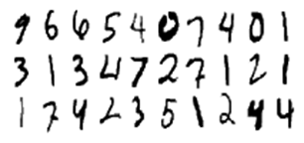

Overview of This CAMCOS
Team 1
Wilson A. Florero-Salinas
Carson Sprook
Dan Li
Abhirupa Sen
Problem: Given an image of a handwritten digit, determine which digit it is.
Team 2
Xiaoyan Chong
Minglu Ma
Yue Wang
Sha Li
Problem: Identify potential customers for direct marketing.
Project supervisor: Dr. Guangliang Chen

Slide 4
Presentation Outline (Team 1)
The Digit Recognition Problem
Classification in our Data Set
Data Preprocessing
Classification Algorithms
Summary
computer
9
Theme: Classification Problem

Slide 5


Classification in our data set
Prediction
New Points
Training Set
Model Training
Training Points
?
Model
Algorithm
Training Labels
0
1
Predicted Labels
9
Goal: use the training set to predict the label of a new data set.
MNIST Data

Slide 6
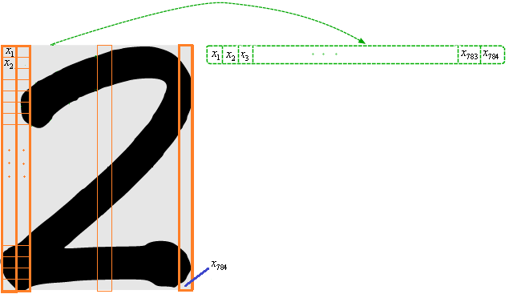
Team 1: The MNIST¹ data set
28x28 images of handwritten digits 0,1,...,9
size-normalized and centered
60,000 used for training
10,000 used for testing
¹ subset of data collected by NIST, the US's National Institute of Standards and Technology

Slide 7
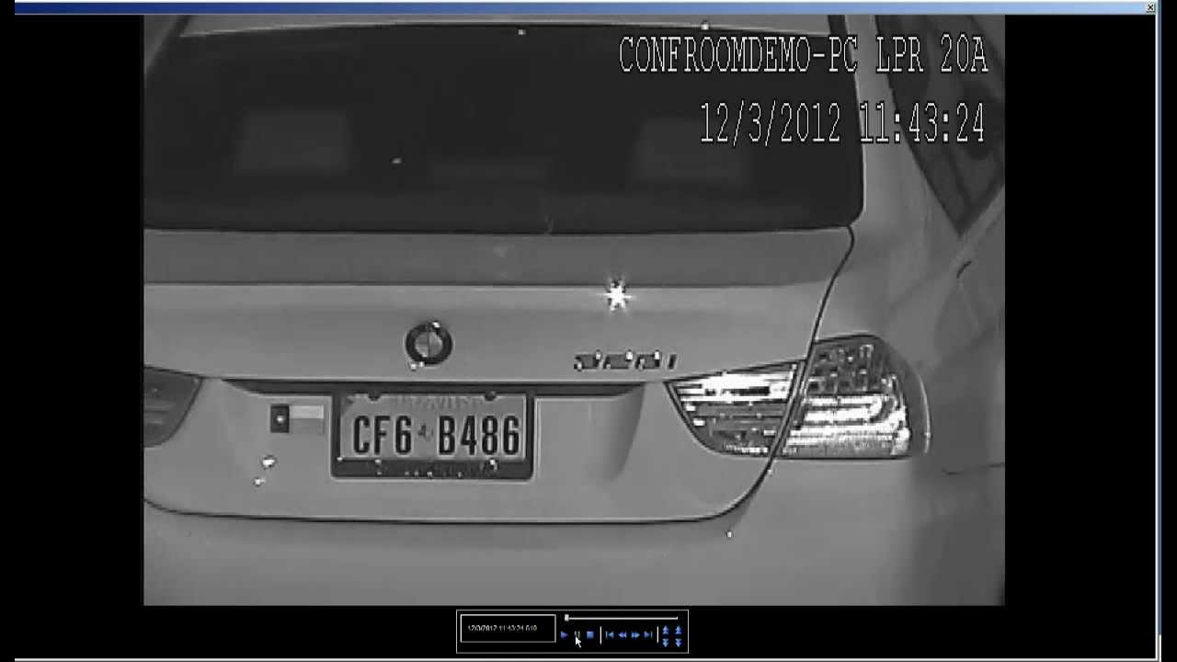
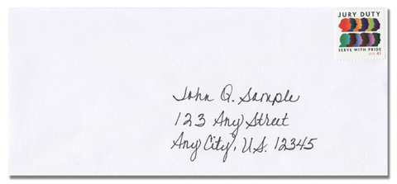
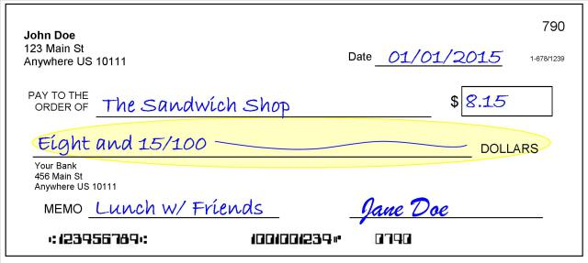
Potential Applications
Banking: Check deposits
Surveillance: license plates
Shipping: Envelopes/Packages

Slide 8
Initial Challenges and Solutions
High dimensional data set
Images stored as 784x1 vectors
Computationally expensive
Digits are written differently by different people
Left-handed vs right-handed
Preprocess the data set
Reduce dimension→ increase computation speed
Apply some transformation→ enhance features important for classification

Slide 9
Data Preprocessing Methods
In our experiments we have used the following methods
Deskewing
Principal Component Analysis (PCA)
Linear Discriminant Analysis (LDA)
2D LDA
Nonparametric Discriminant Analysis (NDA)
Kernel PCA
t-Distributed Stochastic Neighbor Embedding (t-sne)
parametric t-sne
kernel t-sne
PCA & LDA

Slide 10
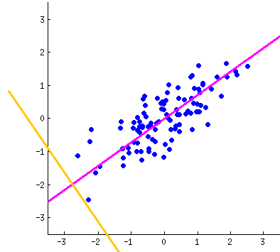
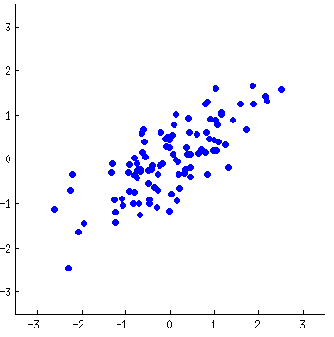
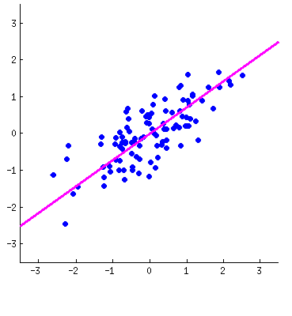
Principal Component Analysis (PCA)
Using too many dimensions (784) can be computationally expensive.
Uses variance as dimensionality reduction criterion
Throw away directions with lowest variance

Slide 11
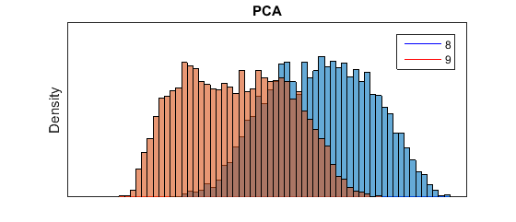
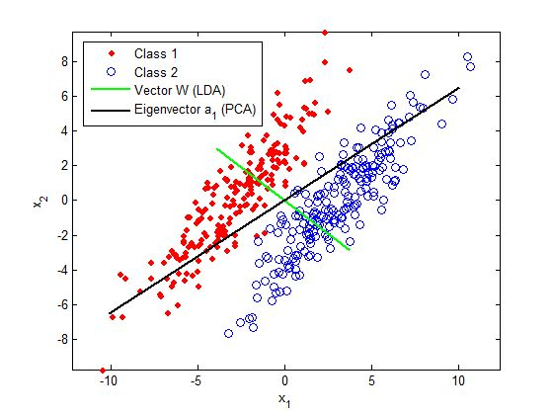
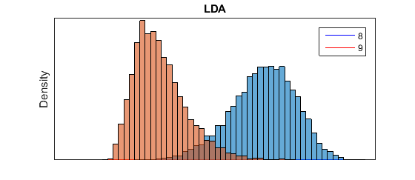
Linear Discriminant Analysis:
Reduce dimensionality, preserve as much class discriminatory information as possible.
Methods

Slide 12
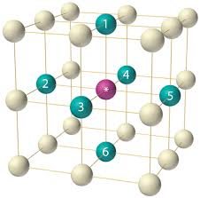
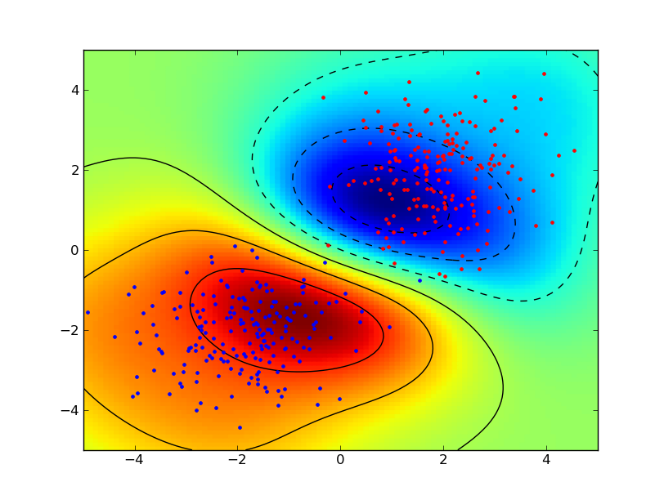
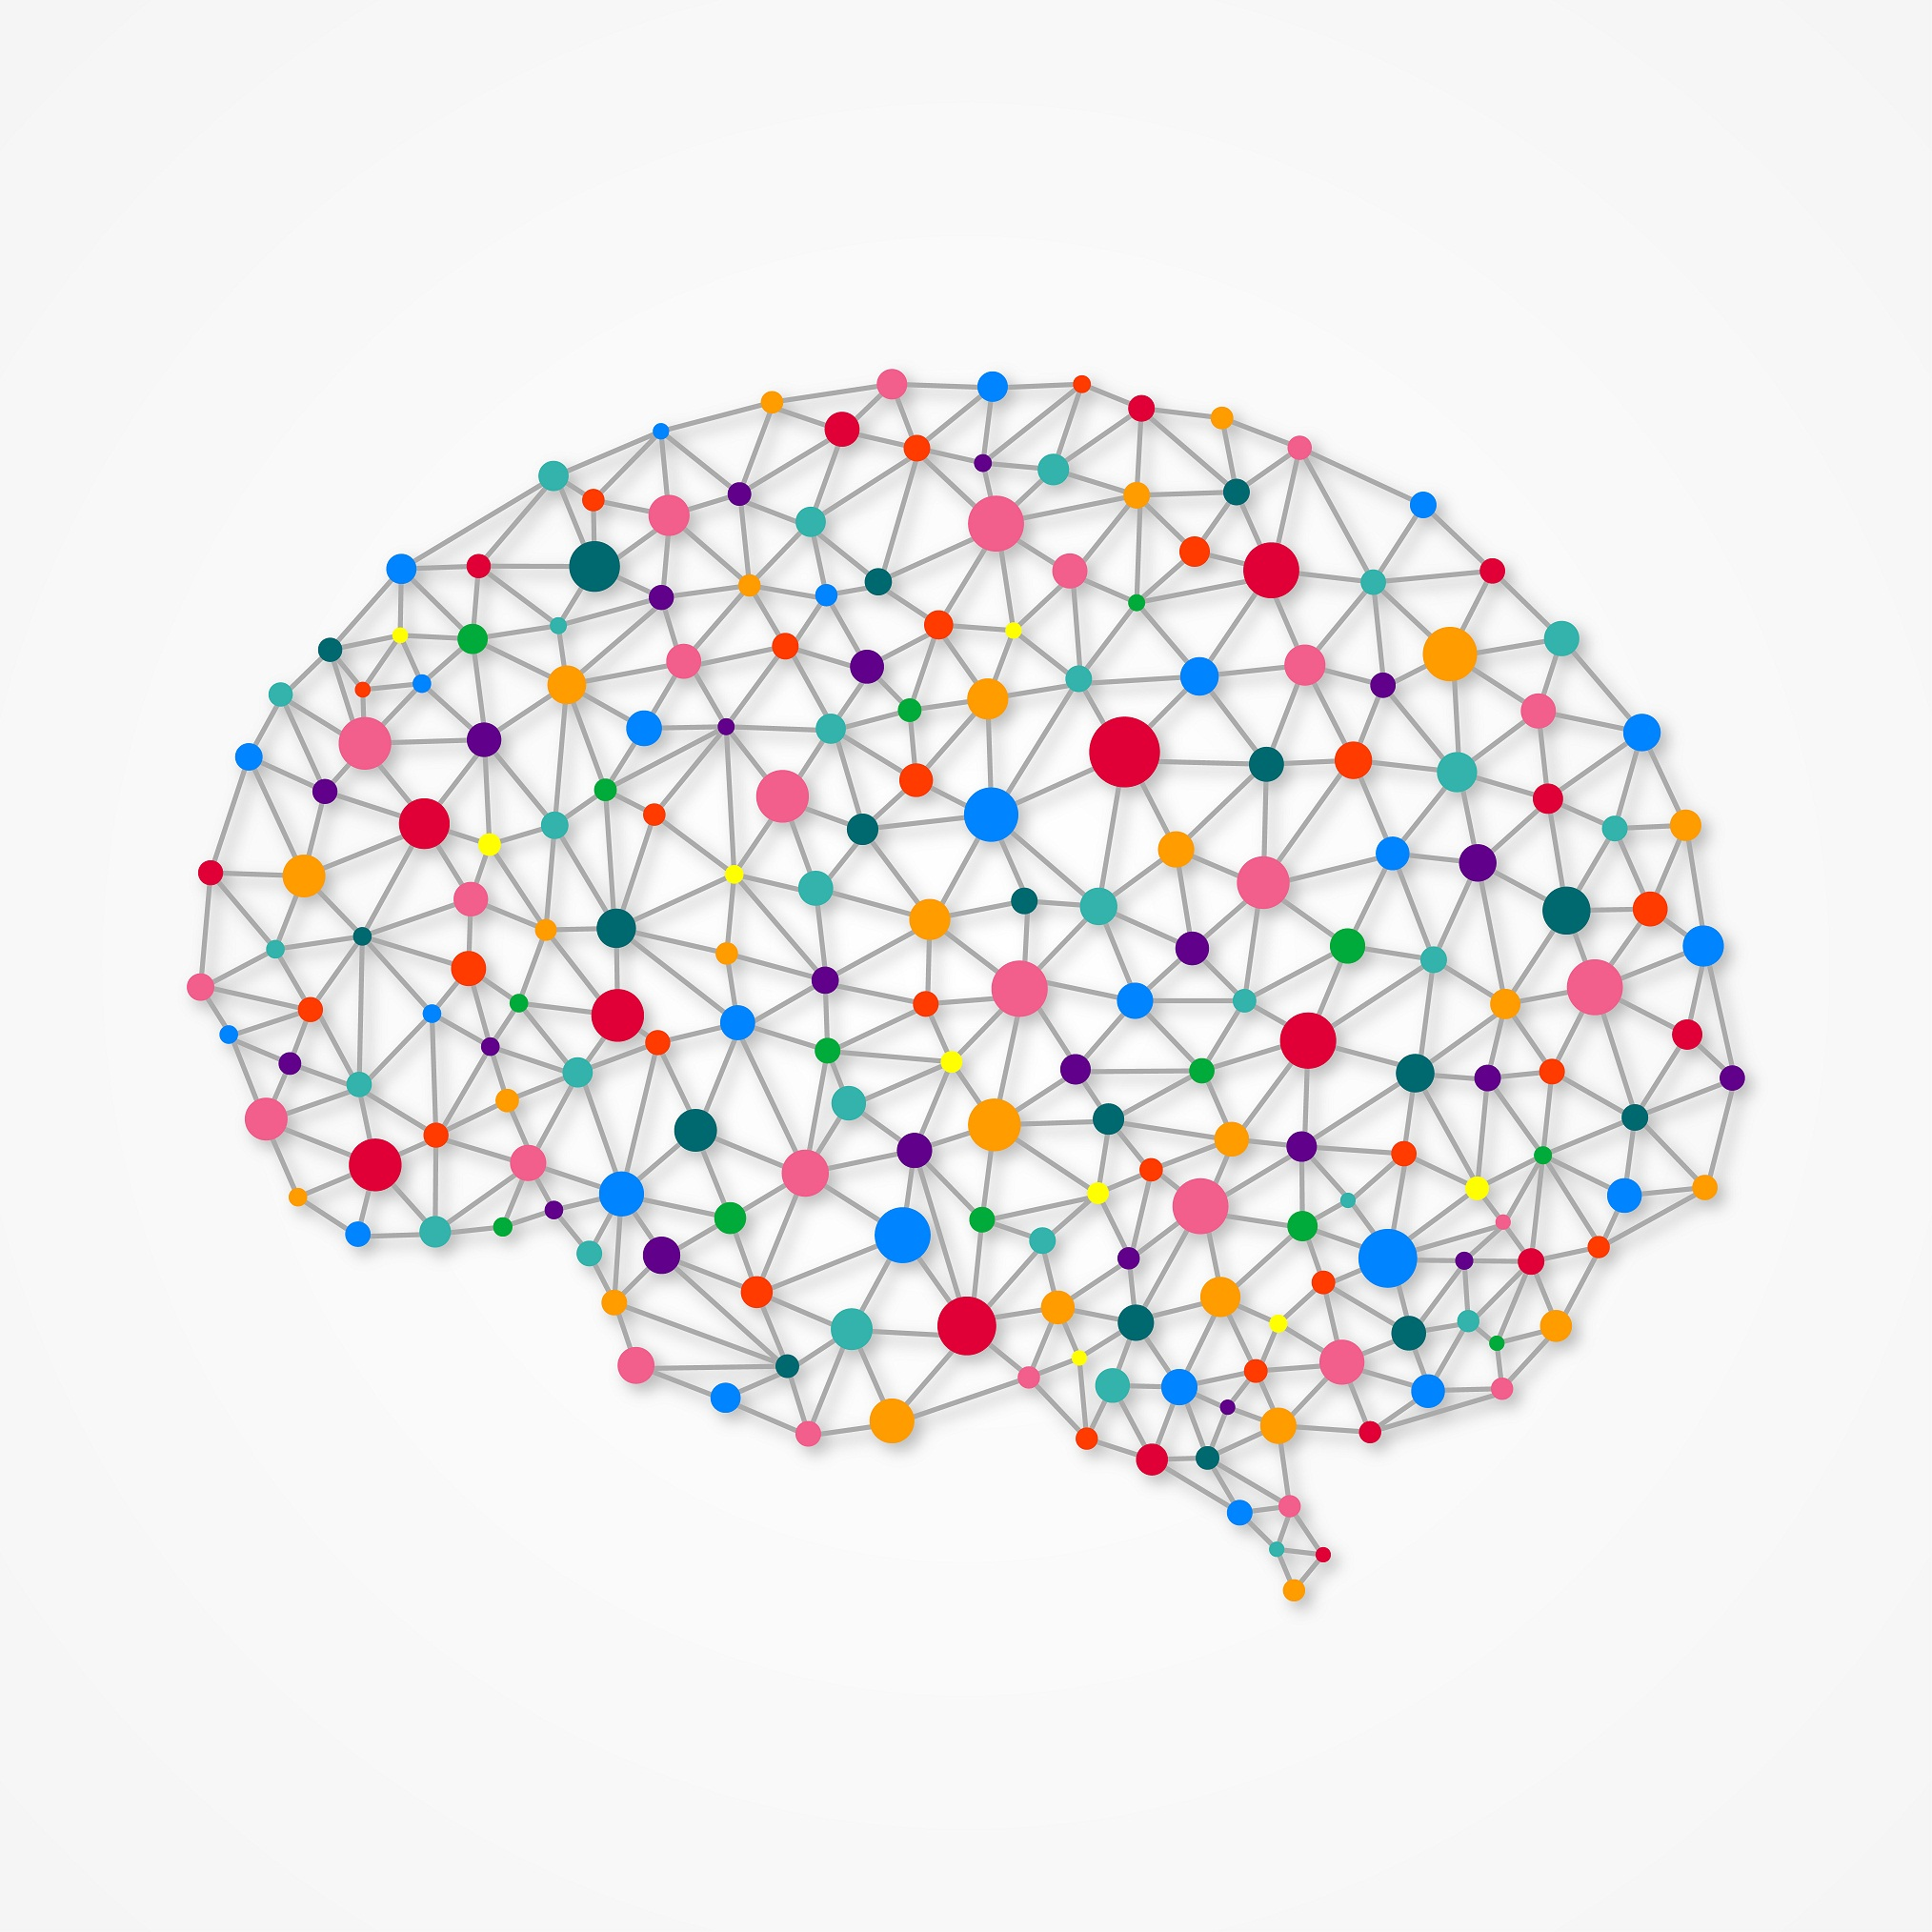
Classification Methods
In our experiments we have used the following methods
Nearest Neighbors Methods (Instance based)
Naive Bayes (NB)
Maximum a Posterior (MAP)
Logistic Regression
Support Vector Machines (Linear Classifier)
Neural Networks
Random Forests
Xgboost

Slide 13
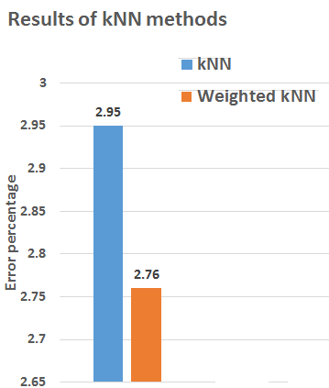
K nearest neighbors
A new data point is assigned to the group of its k nearest neighbors
k = 5
k = 9
Majority of the neighbors are from class 2.
Test data is closer to class 1.

Slide 14
K means
Situation 1: Data is well separated.
Each class has a centroid/average.
Situation 2: Data has non convex clustering.
centroid 1
centroid 1
centroid 2
centroid 2
centroid 3
Test data is predicted to be from class 3.
Test data belongs to class 2.
Misclassified to class 1.

Slide 15
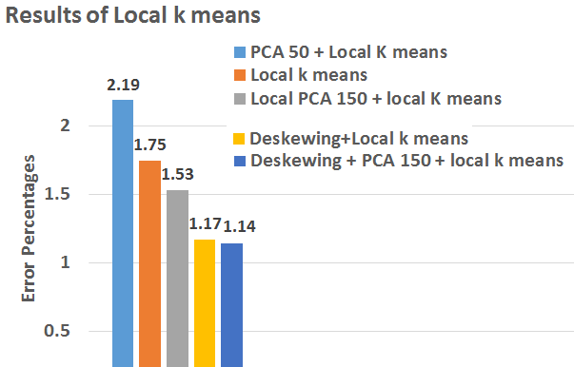
Solution : Local k means
For every class local centroids are calculated around the test data.
SVMs

Slide 16
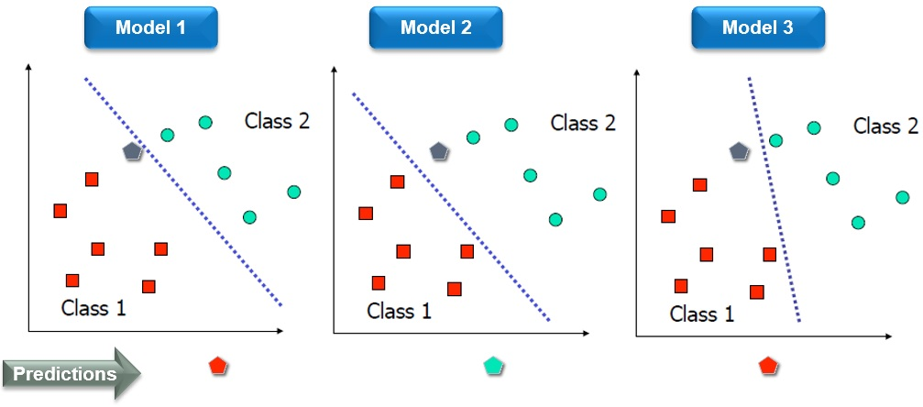
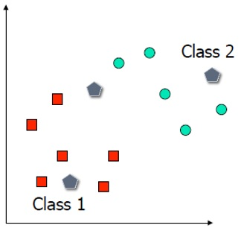
Support Vector Machines (SVM)
classify new observations by constructing a linear decision boundary

Slide 17


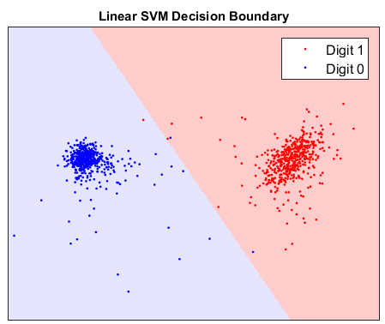
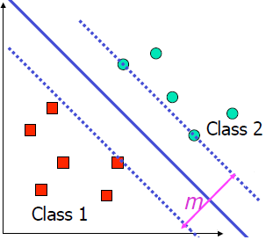



Support Vector Machines (SVM)
Decision boundary chosen to maximize the separation m between classes

Slide 18
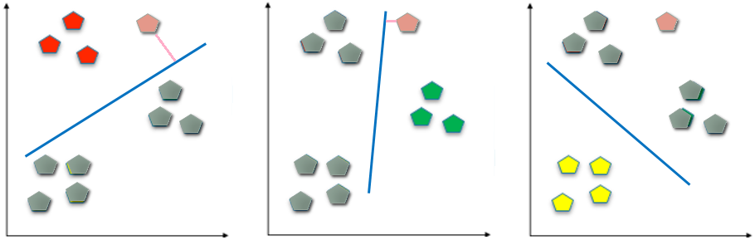
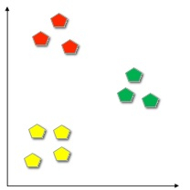
SVM with multiple classes
SVM is a binary classifier. What if there are more than two classes?
Two methods: 1) One vs. Rest 2) Pairs
One vs Rest
Construct one SVM model for each class
Each SVM separates one class from the rest

Slide 19

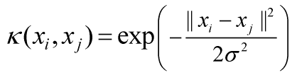
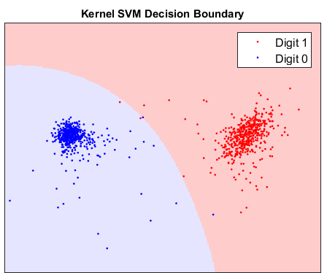
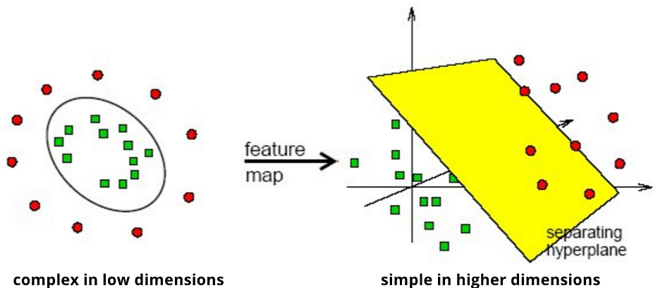

Support Vector Machines (SVM)
What if data cannot be separated by a line?
Kernel SVM: Separation may be easier in higher dimensions

Slide 20
Combining PCA with SVM
Traditionally: Apply PCA globally to entire data
Our approach: Separately apply PCA to each digit space
This extracts the patterns from each digit class
We can use different parameters for each digit group.
PCA
Model 1
SVM1
0 or not 0
largest positive distance from boundary
PCA
Model 2
SVM2
1 or not 1
PCA
Model 10
SVM10
9 or not 9

Slide 21
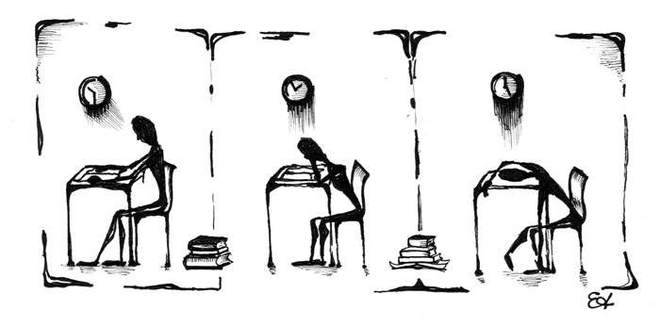

Some Challenges for kernel SVM
It is not obvious what parameters to use when training multiple models
Within each class, compute a corresponding sigma
This gives a starting point for parameter selection
How to obtain an approximate range of parameters for training?

Slide 22
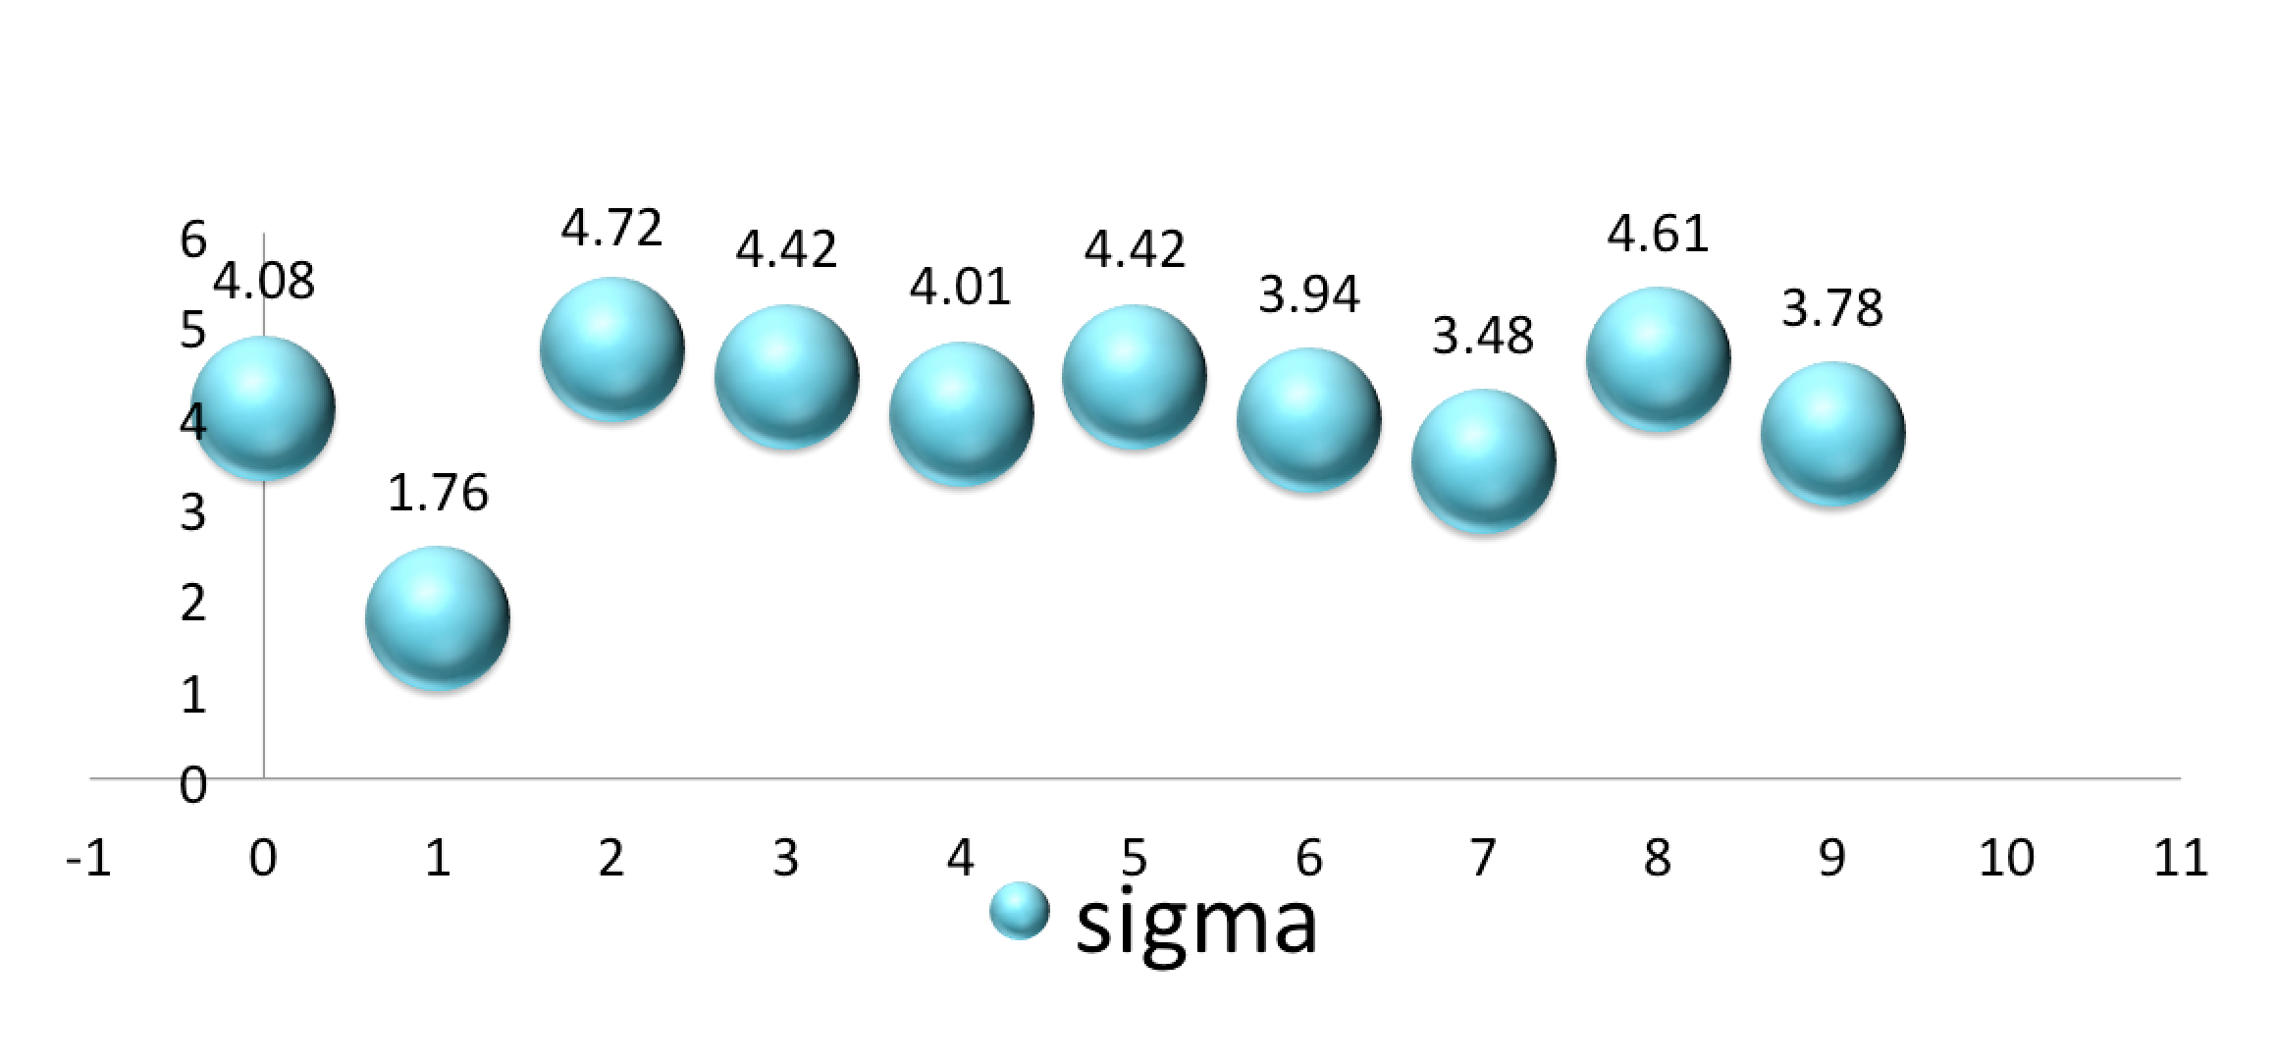
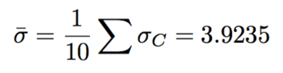
Parameter selection for SVMs
Using kNN, with k=5, sigma values for each class
Error 1.25% using kNN different sigma on each model
Error 1.2% is achieved with the averaged sigma = 3.9235

Slide 23
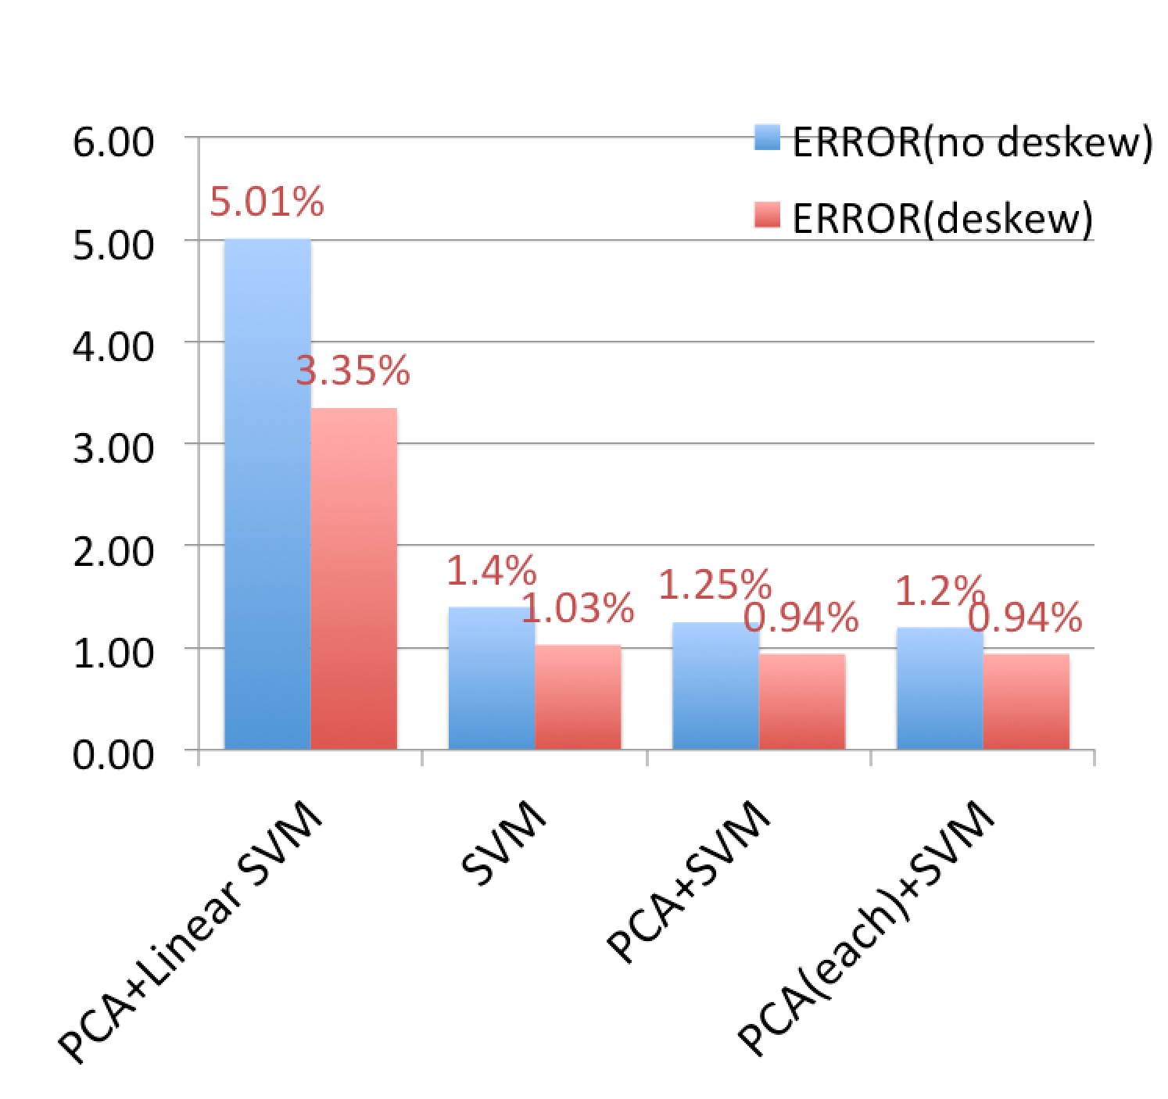
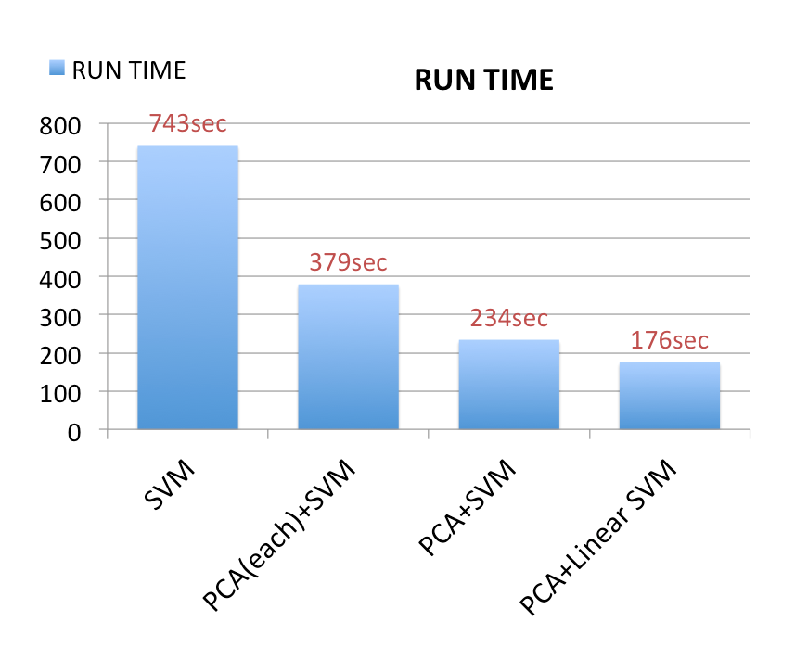
SVM + PCA results

Slide 24
Some misclassified digits
(Based on local PCA + SVM, deskewed data)
6 to 0 3 to 5 8 to 2 2 to 7 7 to 3
8 to 9 7 to 2 9 to 4 4 to 9 4 to 9
Neural Nets

Slide 25
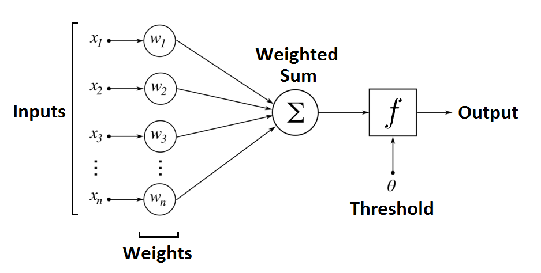
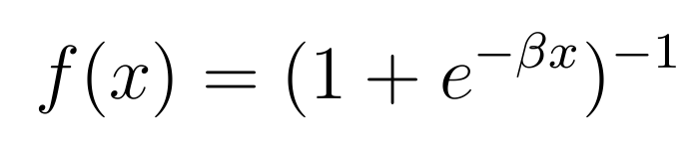
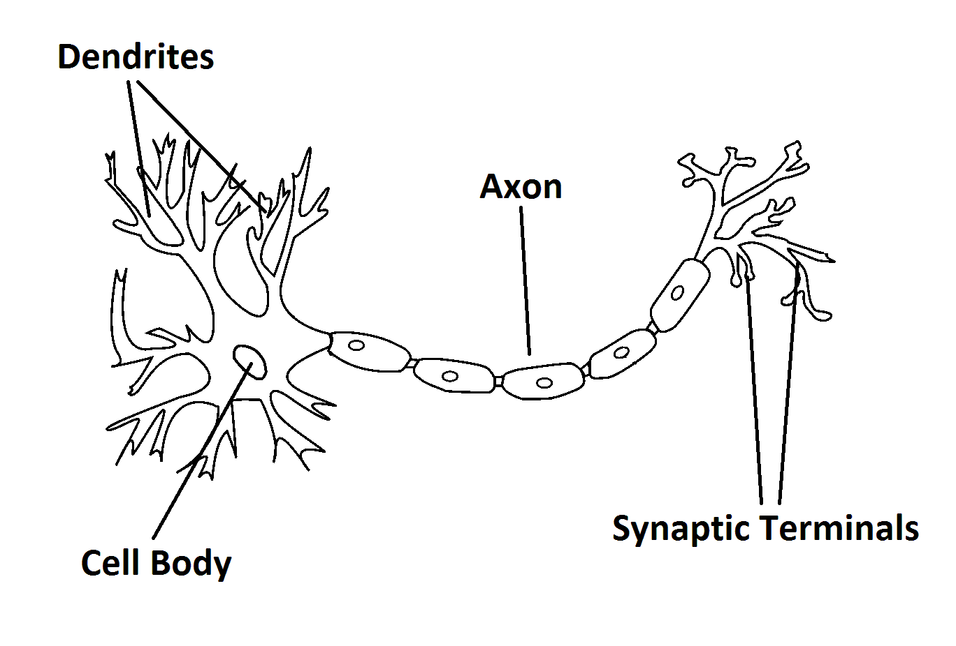
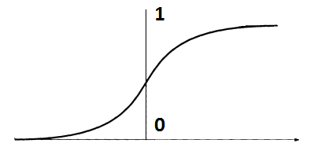
Neural Networks: Artificial Neuron
Notes:
The artificial neuron is a type of binary classifier whose inputs are the components of a vector, which are usually the outputs of other neurons. In the biological neuron, electrical signals from other neurons accumulate on the what is called the dendritic tree. If the charge reaches a critical level, the neuron sends a signal to other neurons connected to the end of it. In place of electrical signals, the artificial neuron uses the weighted sum of the inputs, and if the sum exceeds a certain threshold, the neuron outputs a value of 1, and 0 otherwise.
In order to optimize the weights, the output function must be smooth, so we use an S-curve that lies between 0 and 1 called the sigmoid function. The “sharper” the curve, the closer the sigmoid approximates the strictly binary 0-1 output.

Slide 26
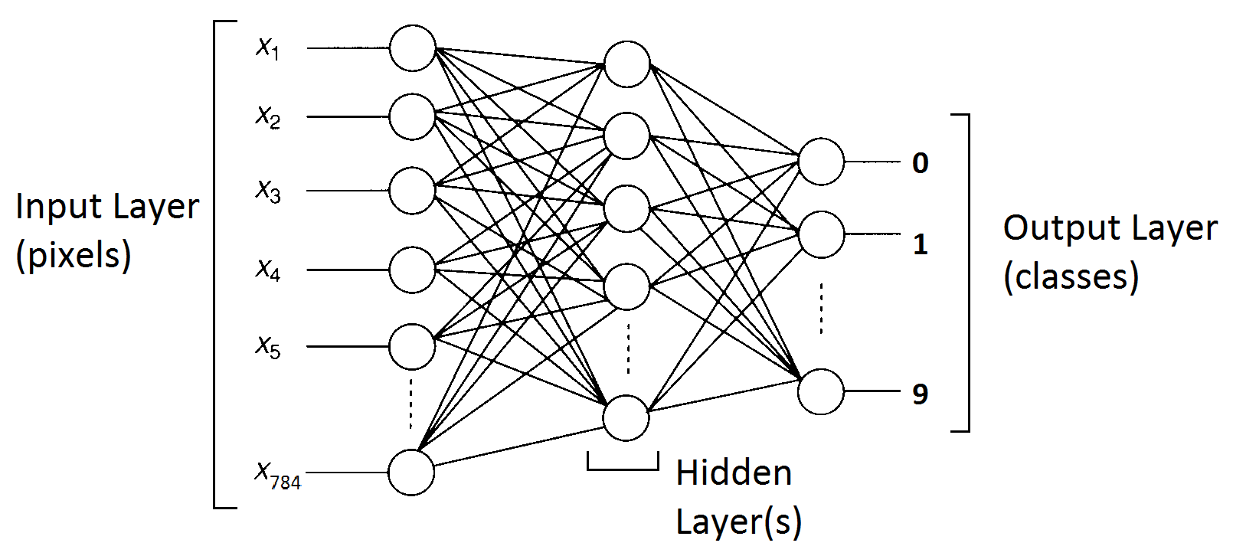

Neural Networks: Learning
Notes:
More complicated classifiers can be constructed by creating a layered network of artificial neurons, where the inputs of each neuron are the outputs of all the neurons in the previous layer. A neural network consists of a layer of input neurons, output neurons, and middle neurons which are called hidden layers. The hidden layers are in charge of recognizing different features of the data. (point out example)
The pixels are fed through the input layer and the image classified according to the output neuron with the highest value. The values of the output neurons can be controlled by the manipulating the weights and thresholds of the neural net, and training the model involves optimizing the weights and thresholds so as to maximize the number of correct classifications on the training set. A scaled gradient algorithm is typically used for this.

Slide 27
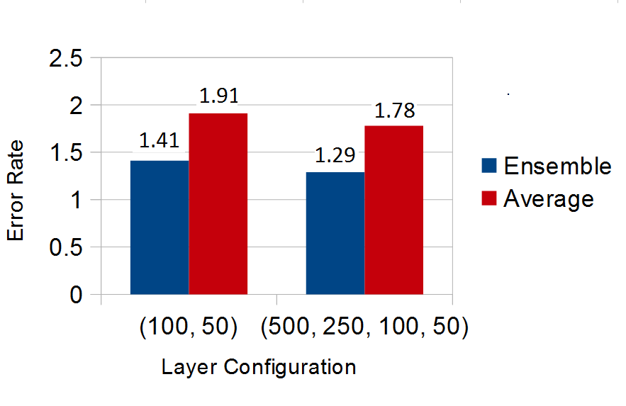
Neural Networks: Results
Classification rule for ensembles: majority voting
Conclusions
Notes:
The training of neural networks requires an initial guess for the values of the weights and thresholds. These are chosen randomly, so results will vary between different networks. What we do is train an ensemble of many models whose outputs are combined, resulting in a lower error rate than one individual model. The way we combine them is simply use majority voting. That is each digit is classified according to what a majority of the models say it is.

Slide 28
Summary and Results
Linear methods are not sufficient as the data is nonlinear.
LDA did not work well for our data.
Principal Component Analysis worked better than other dimensionality reduction methods.
Best results were obtained with PCA values between 50 and 200 (55 being best)
Deskewing improved results in general
Best classifier for this data set is SVM

Slide 29
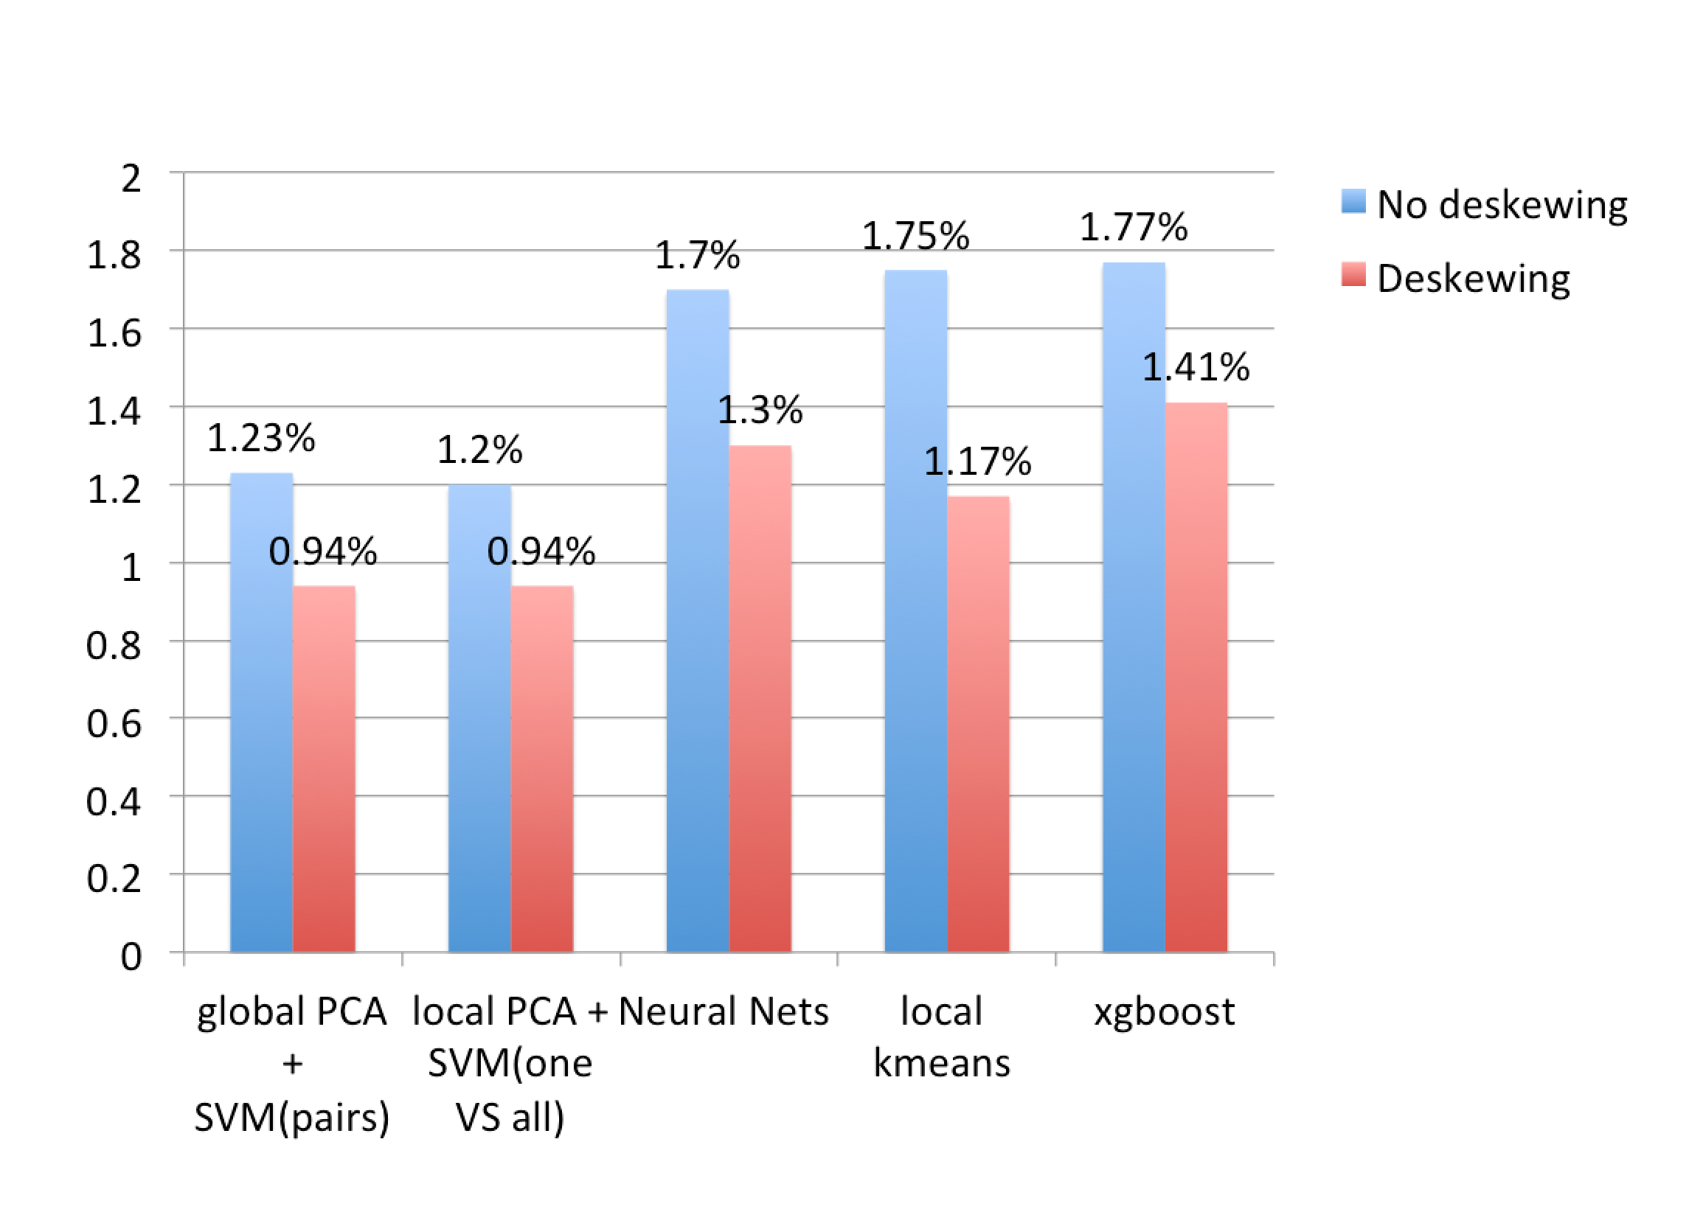
Results for MNIST

Slide 30
Questions?

Slide 31
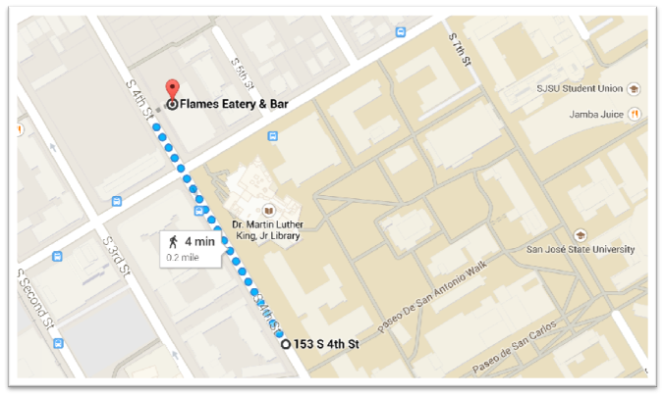
Directions to Lunch

Slide 32
Choosing the optimum k
Local PCA
The optimum k should be chosen with cross validation
The data set is split into a training and a test set.
The algorithm is run on the test set with different k values.
The k that gives the least misclassification is chosen.
For each of the class of digits the basis is found by PCA.
Local PCA has ten bases instead of one global basis.
Each of the test data point is projected into each of these ten bases.

Slide 33
Local Variance
Center
Local k-Center
“Nice “ Parametric Data
“Messy “ Non-Parametric

